Slide 1

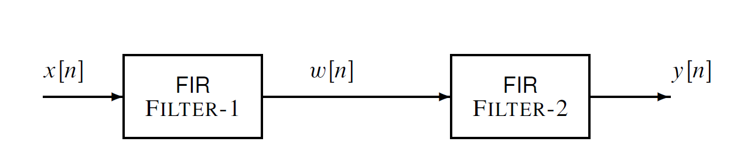
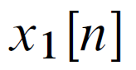
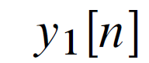

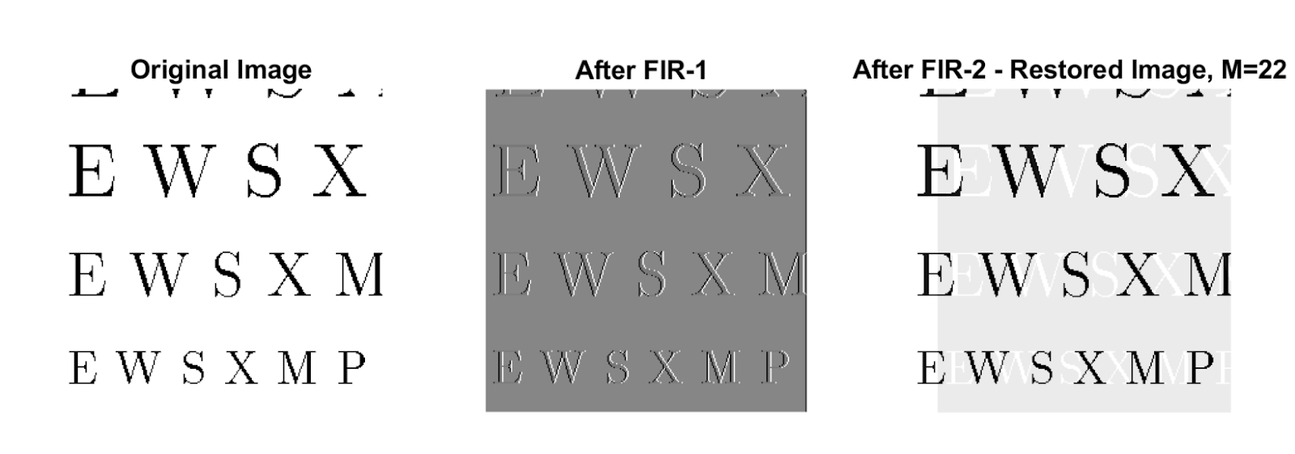
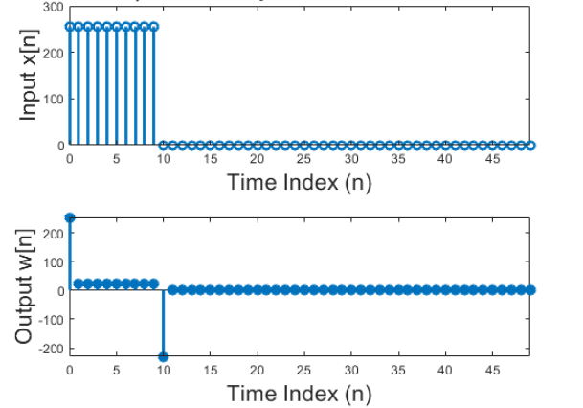
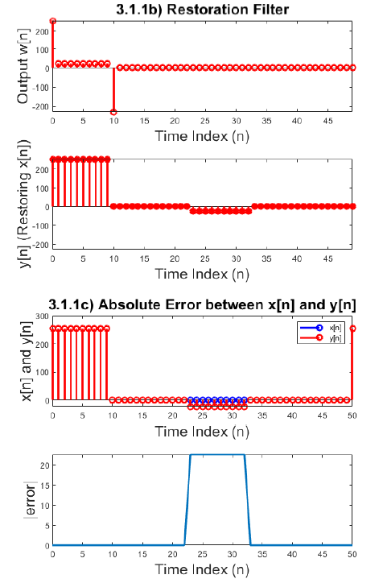
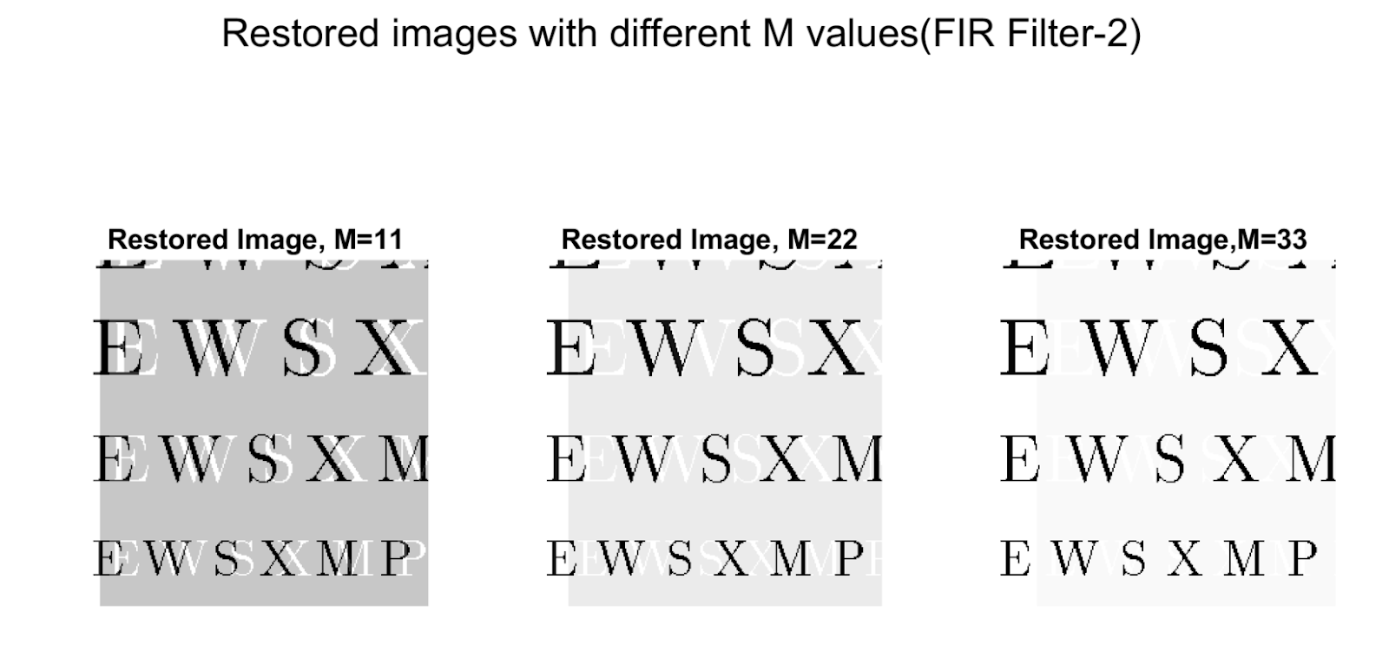
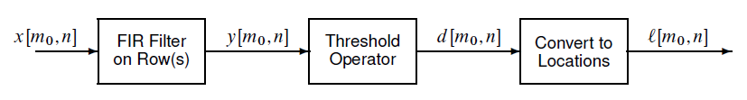
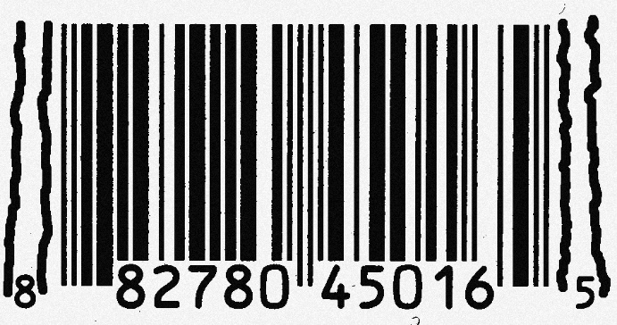
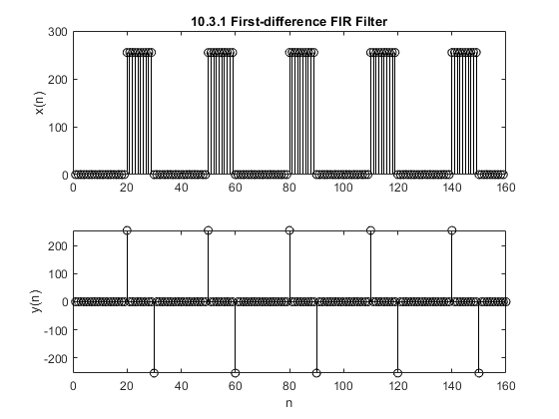
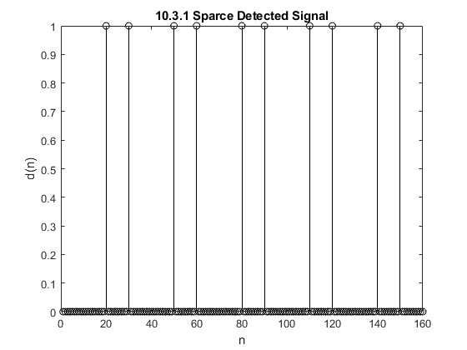
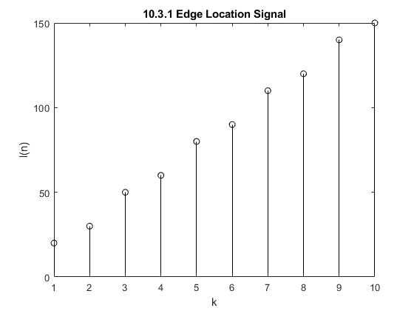
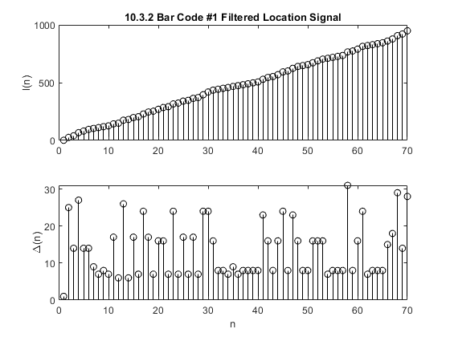
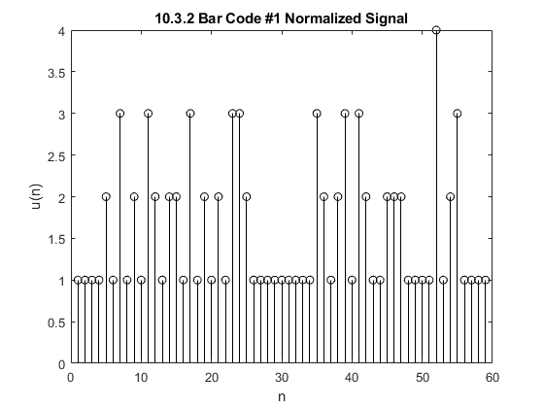





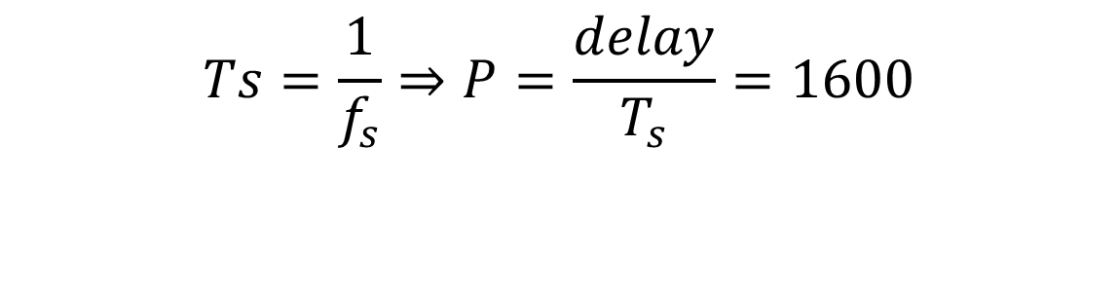
FIR Filters
Aaron Blanchard¹, Antonio Santos Aguilera¹, Caina Fernandes¹, Jason Porter¹
College of
Engineering
¹Department of Electrical and Computer Engineering, University of Utah
Instructor: Neda Nategh/ ECE 6530-090 Spring 2022 (Digital Signal Processing)
Introduction
Audio Effect
FIR filters are frequency-selective filters utilized in a variety of digital signal processing applications in which linear-phase integrity is important. Because FIR filters are computationally expensive compared to IIR filters, designing efficient filtering algorithms can be critical in applications with limited memory storage or a low tolerance for latency. However, FIR filters are inherently stable systems and do not induce phase distortion into filtered signals. Therefore, FIR filters are often used in data, audio, and image processing when data integrity is critical. This project investigates FIR filters commonly used in audio effect manipulation, image restoration, and image edge detection.
Process
Application
Experiment:
An echo was added to an audio recording that was sampled at $f_{s}$=8000 Hz. The time delay and strengh of the echo are 0.2 sec and 90% respectively.
Original Audio
Audio with Echo
$f_{s}$=8000 Hz
delay =0.2 s
r =0.9 (90% of the original)
Click here to listen to Original Audio:
An Echo Filter:
$$Ts=\frac{1}{f_{s}}⇒P=\frac{delay}{T_{s}}=1600$$
$$y_{1}\left[n\right]=x_{1}\left[n\right]−r x_{1}\left[n−P\right]$$
Click here to listen to Audio with Echo:
Methods
Image Restoration
The following FIR filtering techniques were implemented in this research:
Echo:
A linear-phase shift that generates a signal delay with a relative magnitude to the original signal. This phenomenon produces echoes and reverberations in audio signals, as well as “ghosts” in images.
Cascading Systems:
The output of the first system is the input to the second system, and the overall output of the cascade system is taken to be the output of the second system.
$$\begin{aligned}w\left[n\right]=x\left[n\right]−q\left[n−1\right]\left(FIR Filter 1\right)\end{aligned}$$
$$\begin{aligned}y\left[n\right]=\sum_{l=0}^{M}{r^{l}w\left[n−l\right]}\#\left(FIR Filter 2\right)\end{aligned}$$
FIR Filter 1: utilized to create echoes on signals and data sets (audio, and image data).
FIR Filter 2: utilized to (approximately) undo the effect of FIR-Filter 1 . This type of application is called Deconvolution.
Deconvolution:
A signal processing technique used to rectify an undesired convolution. This is useful in image restoration.
First-Difference Filter: $y\left(n\right)=x\left(n\right)−x(n−1)$
A filter designed for detecting significant fluctuations in a signal. This concept is known as edge detection and can be used in many image processing applications including bar code scanning.
Process
Application
1
2
3
Filter Coefficients: FIR Filter 1: q=0.9
FIR Filter 2: r=0.9, M=22
Image degradation and restoration:
1
2
3
1
3
2
Varying M:
Edge Detection
Process
Filter Coefficients:$h\left(n\right)=\{1,−1\}$
Bar Code Decoding
1
2
3
4
Δ = Find(l)
l = Find(d)
1
3
4
2
Conclusion
References
J. G. Proakis and D. G. Manolakis, “Implementation of Discrete-Time systems,” in Digital Signal Processing, Hoboken, NJ: Pearson Education, 2021.
McClellan, J., Schafer, R. and Yoder, M., n.d. DSP first. 2nd ed., Pearson, 2015.
Smith, Steven W. “The Scientist and Engineer's Guide to Digital Signal Processing”. San Diego, Calif: California Technical Pub, 1997. Print.
A simplistic approach to FIR filtering has been achieved in this research to exhibit idealistic filters and their responses. However, in the physical world, additional variables must be considered when designing adaptive, robust filtering systems.
The merit of a deconvolution filter depends greatly on the selected coefficients. In this research, the original convoluted signal was known, which guided the selection of the restorative filtering design. When the original signal is unknown, a more complicated process known as “blind” deconvolution is required.
Bar code scanners are subject to environmental conditions such as contoured or rotated barcodes, variable ambient lighting, and bar code damage. A multi-phase processing system may be required.

